Slide 1

UNIVERSITY OF PETROLEUM & ENERGY STUDIES
School of Computer Science
Dehradun
COURSE: Physical Security July – December 2023
Delivered by
Dr. Gopal Singh Rawat
1

Slide 2
Course Plan
CO1. Introduction to Physical Security CO2. Approaches to Physical Security
CO3. Standards, Regulations and Guidelines
CO4. Fire and Fire Safety Inspection CO5. Vulnerability Assessment CO6. Security Surveys and Audit CO7. Security Lighting, Alarms
CO8. Video, Biometrics, Access Control, Fences
CO9. Security Personnel
2

Slide 3
Chapter 9. Security Personnel

Slide 4

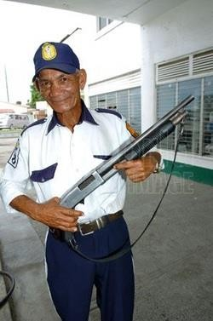
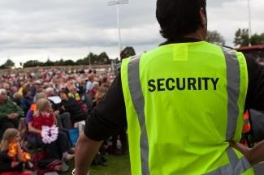

9.1 Security Personnel
Objectives:
Primary: Keep an eye for Rule violation & Reports matters to the authority
Protects assets, goods, environment, services in an organization or industry
Should have understanding of legal aspects – security and protection
Freedom of employees, staff are taken into account when implementing security rules and regulations
Training & Job role is different from law enforcement agencies (local police, CBI, CID, Min. Home Affairs)

Slide 5
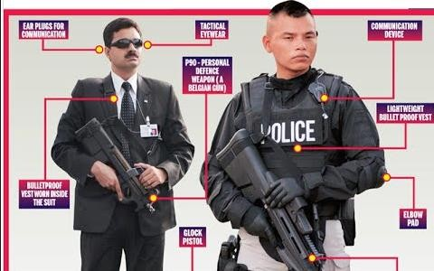


9.2 Types of Security Personnel
Personnel/Private Security Personnel
Armed Security Personnel
Corporate Security Personnel

Slide 6
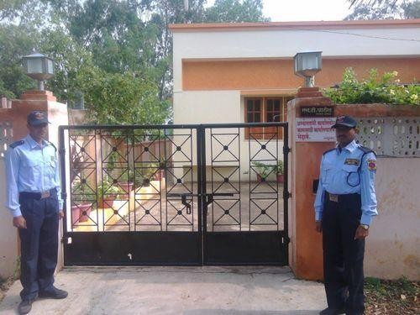
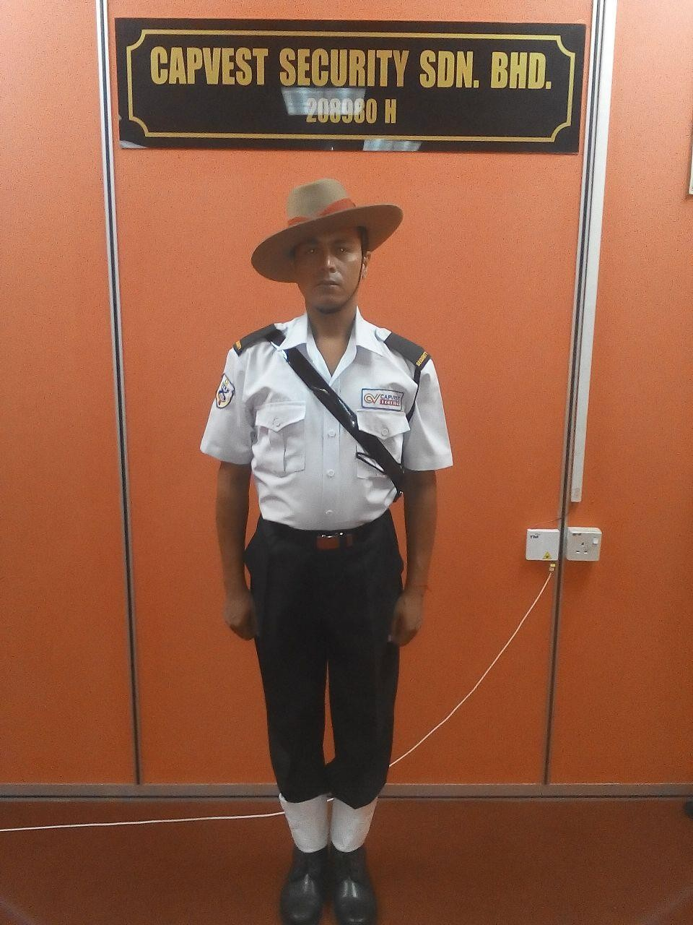
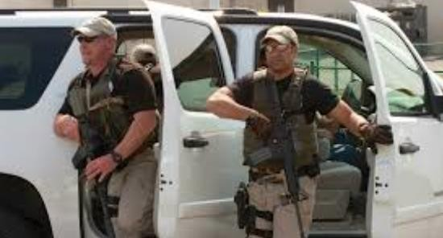
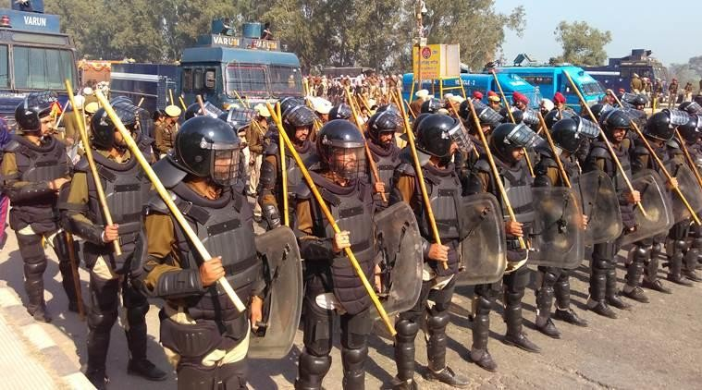
9.2 Types of Security Personnel
Residential Security Personnel
Government Security Personnel
Static Security Personnel
Mobile Security Personnel

Slide 7
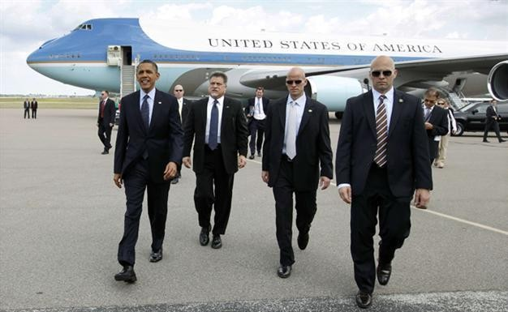
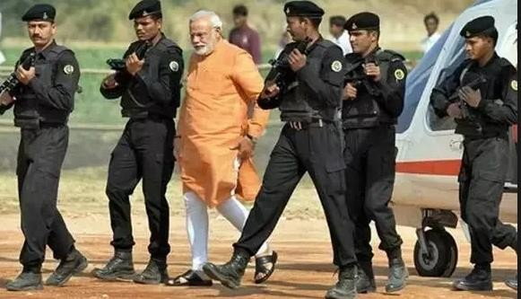
9.3 Executive Protection
Expert protection for High profile VIPs with important status in society
Due to Wealth, Employment or Association by Secret Services or Black Cats
Protection measures include:
Home Security Systems
Email Screening
Armored Vehicles
Plans of Vehicle Scrambling
Travel by private jets
24x7 Bodyguards

Slide 8

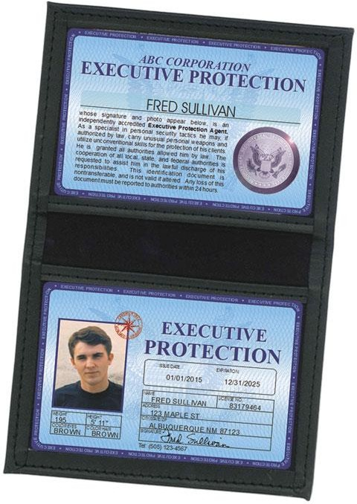
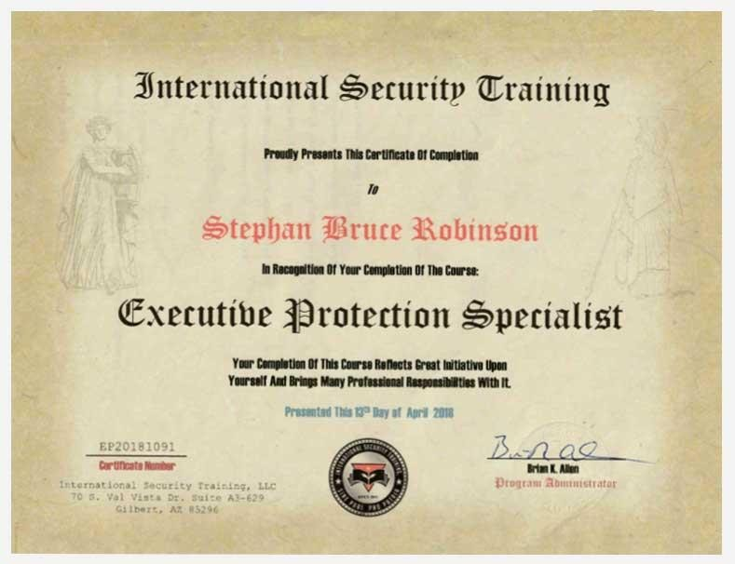
9.3 Executive Protection
Certification in Executive Protection provided by American Society for Industrial Security (ASIS)
International organization for security personnel worldwide, founded in 1955, Cert. launched in 2013
Objective:
Increase effectiveness and productivity of security professionals
Advocates roles and value of security management profession to businesses
Skills and procedures required to provide effective personnel protection
Notes:
American Society for Industrial Security (ASIS)

Slide 9
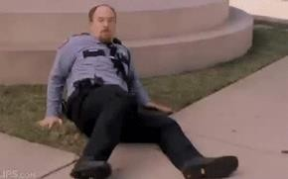
Note:
Security Personnel do not enforce law – If security guard apprehends an intruder
His duty is to inform his superiors and the closest Police station. Cannot Arrest the criminal
9.4 Roles and Responsibilities
Prevent – identify potential risk and try to mitigate the threat – ensure absence of incidents instead of response
Visibility – be noticeable to discourage any malicious and hostile attempt
Vigilance – watchful eye for abnormal activities, events and understand the environment
Observe and Report –
What, Where, Who, When
Demonstrate alertness, maintain calm state of mind, log of incident
Report incident to law enforcement agencies
Get Help – during an event / attack
Team Misc. activities – check badges, IDs, bags, Report hazardous material
Offer Safety Warnings / Tips
Perform other special duties

Slide 10
9.5 Functioning of Security Guard
Training – mandatory
Report Writing –
Inform
Record
Demonstrate alertness
Protect themselves
Weapons Safety
Wearing Firearm
Supervisor
Between security guard and management
Understands Trends, Events, Practices, Legal requirements
Ensure friendly environment for employee – clean, stress free environment
Ensure right-actions are performed, condemn wrongful actions
Keep open communications – suggestions / inputs encouraged
Leadership – appreciate staff, role model

Slide 11
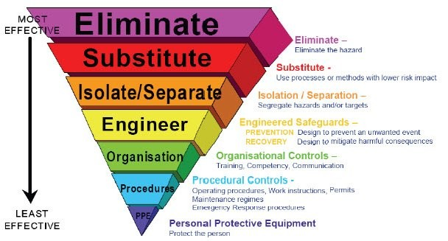
9.6 Hazard Assessment
Hazard is any practice, behavior, substance, condition or combination of these that can cause injury, harm, illness to people or damage to environment and property.
Assessment is the process of identifying hazards so that they can be eliminated or controlled.
Principles of hazard control

Slide 12
9.6 Hazard Assessment
Application of Hazard Controls
Design Reviews –
Review plans and specifications of site/product (office of risk management ORM)
Ensure compliance for Standards and industry practices (human / environment safety and industry hygiene)
Operating Procedures –
SOPs – directives developed by departments / organizations
Health and Safety regulations
Purchasing Procedures –
Incorporate Health and Safety specifications before releasing orders
Little control over requirement / specification but ensure safety for Contract workers, staff, employees, students
Interim and Permanent Hazard Abatement
Admin Controls and Personal Protective equipment
Adopt existing / available technology, avoid new, risky

Slide 13
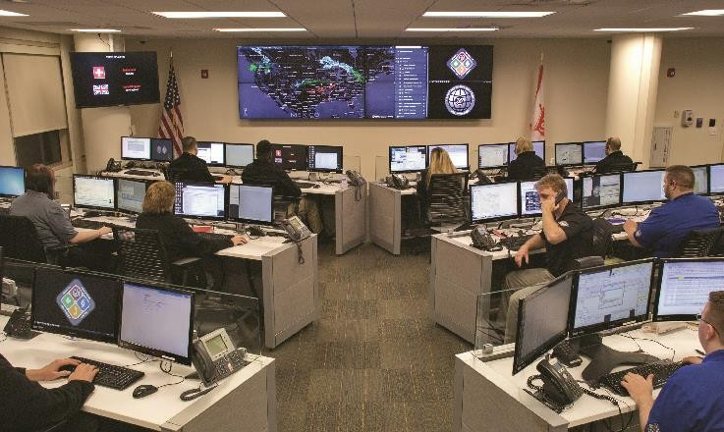
9.7 Crisis Management
Application of strategies designed to help organization to deal with sudden and significant negative event.
Sudden potential risk – lead to unpredictable consequences or event
Future planning of potential crisis is done in advance. No Firefighting.
Identify all possible probabilities and possibilities of possible incidents
Select action team for crisis management
Involve stakeholders

Slide 14
9.7 Crisis Management
Steps for Crisis Management Planning
Enlist all Hazards, Assets and their Impact (Potential, Possible, Probable)
Hazards
Assets at Risk
People
Property (building/Infra)
Supply Chain
Systems / Equipment
I T
Business Operations
Reputation
Service Level Agreements
Contracts
Regulatory Obligations
Environment
Impact
Casualties
Property Damage
Business Interruption
Loss of clients / customers
Financial Losses
Environment contamination
Loss of confidence in organization
Fines
Lawsuits
Penalties
Natural
Man-made
Fire
Explosion
Material – spill/release
Terrorism
Workplace violence
Pandemic disease
Utility outage
Mechanical breakdown
Supply failure
Cyber attacks
Plan specific actions to be taken
Identify Spokesman
Maintain Transparency
Inform Employees, Suppliers, Contractors, Clients
Use Social Media, all communication options available (Calls, Conference, Webinar, Skype, Email, SMS…)
Update Status regularly

Slide 15
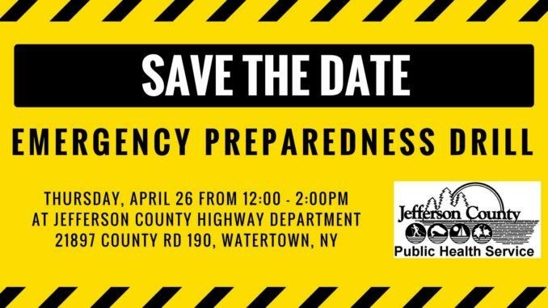
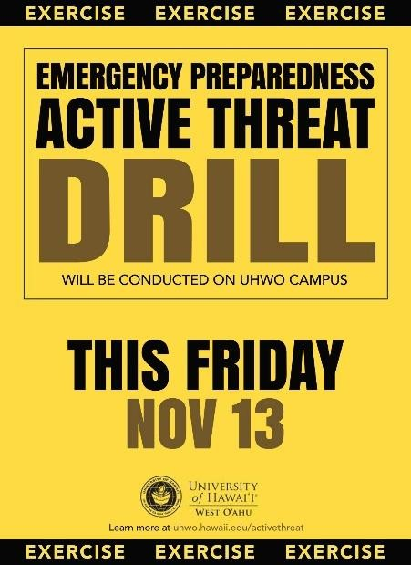
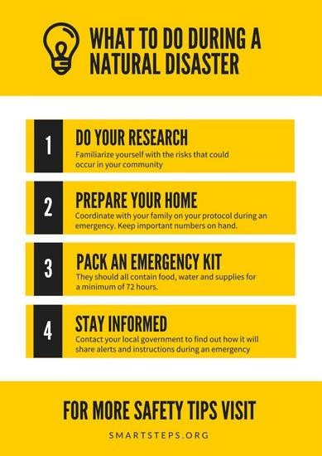
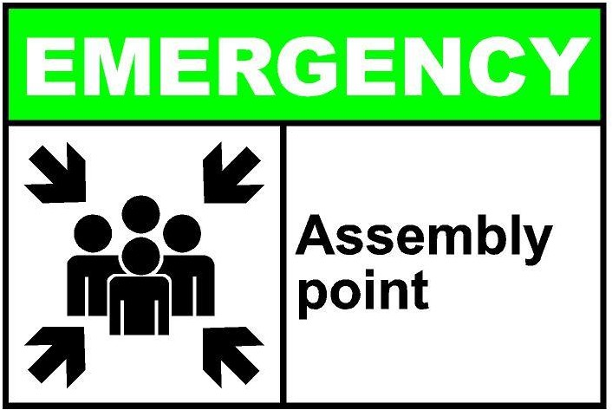
9.7 Crisis Management
Emergency Drills
Aim
Plan to respond during emergency is provided
Exit routes, Evacuation process, Contacts (responsible)
Test effectiveness and conditions
Plan
Building Type – floors, stairs, lifts, construction material, department?
Routes of escape
Train staff, develop awareness
Prepare
Team that would take action during the emergency - Responsibilities / Roles
Plan of action
Area of Assembly

